Slide 1
AEM 6.4 – Summit Live Trials

Slide 2
1 | Experience Fragments/Target Integration
2 | Content Fragments/Service Models and Instances
3 | Style System and Version 2 Components
4 | Smart Crop, Smart Tags, Smart Translations

Slide 3
Style System
Experience Fragments

Slide 4
TRY IT:
Notes:
Scenario: A promotion for the El Gordo jacket is required for use across the We.Retail web site.

Slide 5
1 | Experience Fragments/Target Integration
2 | Content Fragments/Service Models and Instances
3 | Style System and Version 2 Components
4 | Bulk Export Assets Meta Data

Slide 6
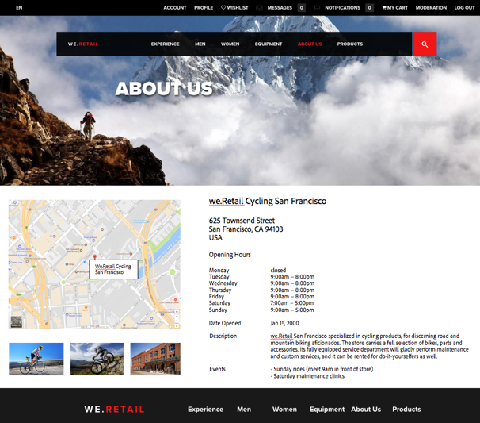
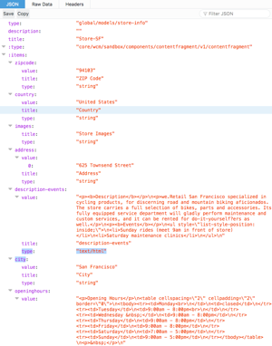
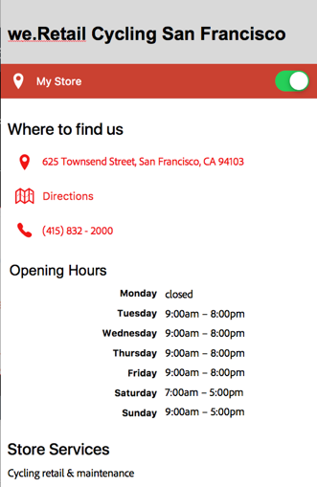
AEM Content Fragments & Services – Use Cases
Create, manage and deliver structured content to any channel
For example
Store locator
User/employee /contact information
Header/footer content
AEM Content Fragments & Services
Notes:
Create, manage and deliver structured content to any channel
Content Fragment model can be easily created using the editor tool
Content Fragment model editor provides a list of data types to create a model with mixed content type
Data types include - Single Line Text, Multi-Line Text, Number, Enumeration, Boolean, Date and Time, Tags and Content Reference
Full set of AEM Rich Text Editor (RTE) functions and RTE Full Screen
Easy to add and delete data elements from the content model

Slide 7
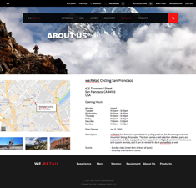
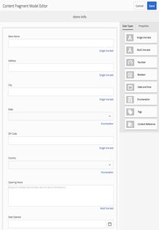
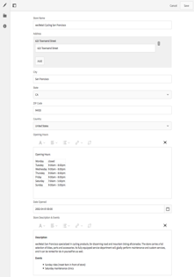
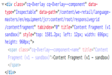
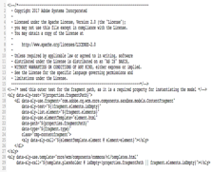
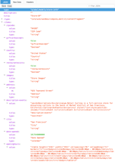
AEM Content Fragments & Services - Personas
1. Information Architect
2. Content Author
3. AEM Developer
4. AEM Web Producer
Web Page
AEM Content Fragments & Services - Personas
5. Web Developer
HTML
Component
Mobile App
Single Page App
...
Content Model
Content Fragment
{API}
JSON
AEM Content Fragments & Services
7

Slide 8
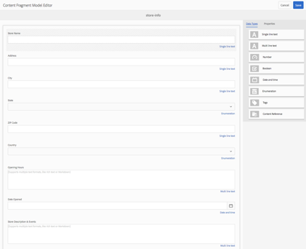
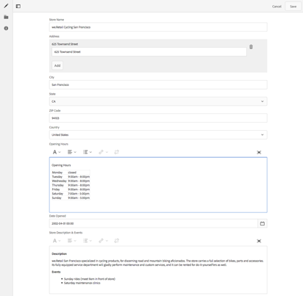
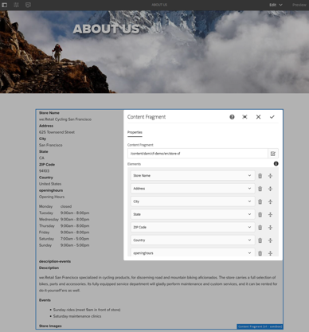
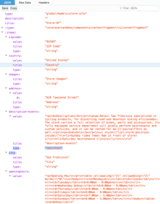
AEM Content Fragments & Services - Technology
Content Model Editor
Information Architect / AEM Developers
Define model (template, schema) for content fragments, including
Elements, based on con tent types
Properties
Default content
Content Fragment Editor
Content Author / Copy writer
Author content into structured Content Fragment elements
Content Fragment Core Component
AEM Developer / Web Producer
Define which elements of a fragment to to output, and how
HTML
JSON

Slide 9
TRY IT
Notes:
Scenario: We.Retail is starting an initiative to create a series of Athlete profiles to support their marketing inititatives. The athlete content will be used on the We.Retail web site and is also consumed by third party partner web sites as well as mobile apps and even a promotion using Amazon Alexa.
The 3rd party partner web sites/apps require the ability to make a JSON call to a single HTTP end point that must deliver a JSON rendition of the features athletes.

Slide 10
1 | Experience Fragments/Target Integration
2 | Content Fragments/Service Models and Instances
3 | Style System and Version 2 Components
4 | Smart Crop, Smart Tags, Smart Translations

Slide 11
Style System
Allows a template author to define style classes in the content policy of a component.
Provides an alternate visual variation for a component.
Eliminates the need to develop a custom component for each style.
Leads to more reusable components
Components can be quickly and easily adapted to the needs of content authors without any AEM back-end development.
Style System

Slide 12
Style System-Use Case
Template authors need the ability to configure a number of alternative visual variations of a component
Content authors need the ability to select how their content is presented visually.
The style system provides a unified solution to both the template author's and content author's requirements:
Template authors can define style classes in the content policy of components.
Content authors can then select these classes from a drop-down when editing the component on a page in order to apply the corresponding styles.
Style System

Slide 13
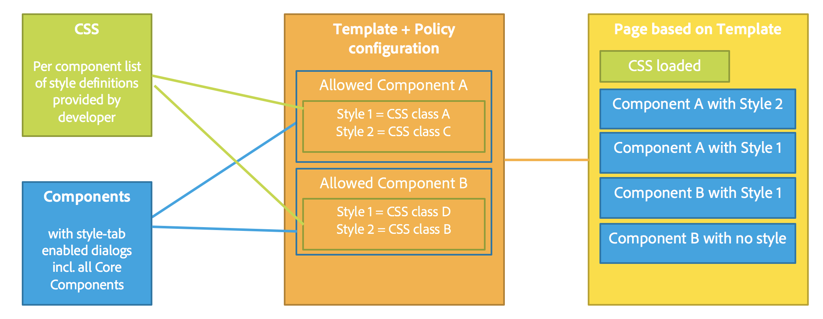
Style System-Overview
Style System

Slide 14
Core Components
The core components provide robust and extensible base components and are available as Adobe and community maintained open source components.
Core components are available with AEM 6.4 and can also be downloaded from Github.
Some of the new core components (V2) include:
Navigation Component
Language Switcher Component
Quick Search Component
Teaser Component
Style System

Slide 15
TRY IT
Notes:
Scenario: To help make the We.Retail site a little more exciting, the brand team has approved a few new stylistic variations to the We.Retail title component. The approved styles include a red border, light grey background and red text. The goal is to have authors use these new styles in creating content.

Slide 16
1 | Experience Fragments/Target Integration
2 | Content Fragments/Service Models and Instances
3 | Style System and Version 2 Components
4 | Smart Crop, Smart Tags, Smart Translations

Slide 17
Content Intelligence: Smart Tags
The next-generation of Smart Tags uses a self-learning algorithm to recognize images and populate tags based on your unique business taxonomy.
Notes:
Sensei learns from your taxonomy and tags to assist with cataloguing, making assets more findable & reusable
Intelligently discover images: Smart Tags automatically adds metadata keywords and helps Experience Manager Assets users discover relevant images in an instant. Enhancements to Smart Tags takes this a step further, leveraging an algorithm that can be easily trained to recognize a company’s image attributes and add relevant tag values. As a brand’s library and taxonomy expands, Adobe Sensei continues to learn, recognizing business-specific image features more quickly.

Slide 18
Content Intelligence | Smart Crop
Non-destructive editing selects the appropriate area of the asset and automatically crops to the precise standards powered by Adobe Sensei
Notes:
Eliminate tedious work by automatically detecting and cropping the focal in an image, capturing the intended point-of-interest. Deliver the best experience for any screen.
_______________________________
Use Case
1) Responsive Banners - Automatically crop banners to preserve the point of interest for responsive design. These are typically hero banners that are featured prominently on the most important pages of the site. As an example, they usually appear on home or category pages or look-books of retailer websites such as:
https://www.macys.com/social/fashion-trend-report/ (resize browser to see banners cropped)
2) Swatch Generation - Swatches are a very small thumbnail that typically resides on the product detail page and shows one color/pattern of a product that contains multiple color/pattern options. As user clicks on the color swatch, the image of the product in that color/pattern would display. Currently customers use a fixed crop setting that attempts to find the color area typically in center of image under assumption that most photography centers the product. But sometimes, depending on the photography, this may not be captured properly - instead it shows the white background or does not fully center the color swatch. The idea is that smart crop could be used to more intelligently find the color swatch. Examples include:
https://www.landsend.com/products/womens-supima-print-cardigan-sweater/id_303715?sku_0=::3D3
http://www.brooksbrothers.com/Non-Iron-Regent-Fit-Button-Down-Collar-Dress-Shirt/118Q,default,pd.html?dwvar_118Q_Color=FBLU&contentpos=11&cgid=0203
3) Text - note images with text are not a good use case for smart crop since we do not have any smart text reflow capabilities. However, this is not an issue because the logic for reflow and position of text happens in customer's web content mgt solution today. In other words, the text is really not part of the file – just the image content. The text is designed and added separately for SEO reasons and for content localization.
The problem being solved
Customers need to deliver images to multiple screens/devices and commonly use responsive design techniques to serve different variations of that image to desktop, tablet or mobile experiences. The problem is an image banner that looks good on desktop will not look good on mobile form factor due to limited real estate. Today, customers manually crop that banner to preserve the point of interest (ie. the model in that banner) while removing the non-essential content (ie. the background in that banner). This cropping is time consuming and expensive - customers either employ their own internal expensive designers to do this or outsource to a design agency. Smart crop eliminates the time and cost of manual cropping by providing an automated approach.How this feature solves the problem
Smart crops uses a Sensei AI algorithm to automatically:
1) crop banners to preserve the point of interest
2) crop product images to generate a representative swatch of the product color/pattern/variation
How to position with customers?
Smart crop leverages the power of Sensei to eliminate the time-consuming and costly tasks of cropping content for responsive design and/or product swatch generation.

Slide 19
TRY IT
Notes:
Scenario: We.Retail needs to set up smart tagging to automatically tag images. There will be some custom images as well and We.Retail wants to leverage AI to recogize their own products. Some of these may need to b cropped. In addition, authors in Spain will need to be able to search for these assets in Spanish.

Slide 21
Summit 2018 GitHub Repo
https://github.com/Adobe-Marketing-Cloud/Summit2018

